Slide 1
Studying the Privacy-Utility Trade-off of Word Embedding Perturbations with a Focus on Sensitivity Analysis and Vector Mapping
7th August 2023, Master Thesis Kick-off
Alisha Riecker

Slide 2
Outline
1. Motivation
2. Research Questions
3. Methodology
4. Initial Findings
5. Next Steps
6. Timeline

Slide 3






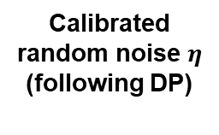
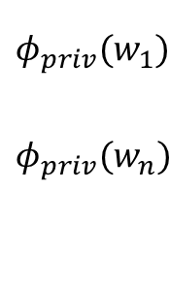
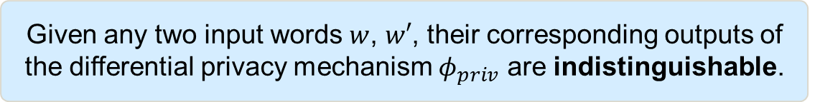



Motivation – Differential Privacy for Word Embedding Vectors (1)
Given any two input words $w$, $w′$, their corresponding outputs of the differential privacy mechanism $φ_{priv}$ are indistinguishable.
User 1
Text 1
NLP Application
Privatized word embedding vectors
User 2
Text 2
Data Collector
(untrusted)
User 3
Text 3
…..
Calibrated random noise $η$
(following DP)
Embedding
function $Φ$
Privatized word embedding vectors
User m
Text m
$$w_{1}$$
$$w_{n}$$
$$φ(w_{1})$$
$$φ(w_{n})$$
+
$$η$$
$$η$$
$$φ_{priv}(w_{1})$$
$${φ_{priv}(w}_{n})$$
=
Text i
….
…
….
...
+
=

Slide 4

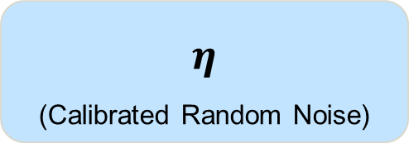
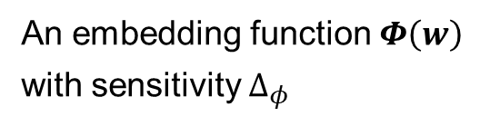

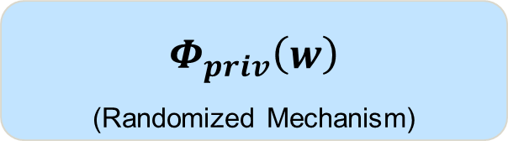
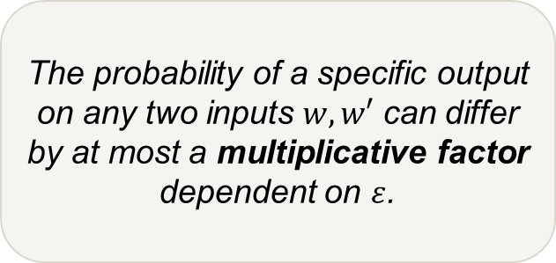
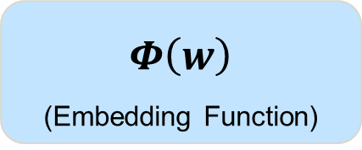
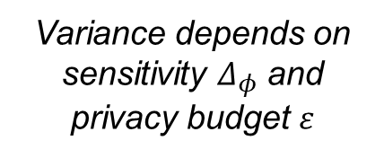
Motivation - Differential Privacy for Word Embedding Vectors (2)
$$Φ\left(w\right)$$
(Embedding Function)
+
$$η$$
(Calibrated Random Noise)
=
$$Φ_{priv}\left(w\right)$$
(Randomized Mechanism)
Example: Laplace Mechanism
$Φ_{priv}$ is $ε$-differentially private
An embedding function $Φ\left(w\right)$
with sensitivity $Δ_{φ}$
$$η \sim Lap$$
Sensitivity describes the maximum possible change in a function‘s output when the input is changed.
The probability of a specific output on any two inputs $w, w′$ can differ by at most a multiplicative factor dependent on $ε$.
Variance depends on sensitivity $Δ_{φ}$ and privacy budget $ε$
© sebis
4

Slide 5



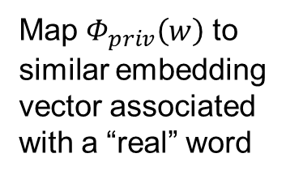
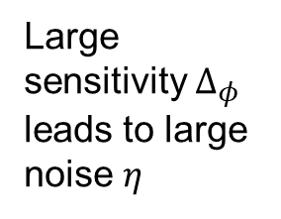

Motivation - Differential Privacy for Word Embedding Vectors (3)
$$Φ\left(w\right)$$
(Embedding Function)
+
$$η$$
(Calibrated Random Noise)
=
$$Φ_{priv}\left(w\right)$$
(Randomized Mechanism)
Large sensitivity $Δ_{φ}$ leads to large noise $η$
How can sensitivity be bounded?
Bound sensitivity
How does the bounding affect the Privacy-Utility Trade-off?
What can the mapping look like?
Map $Φ_{priv}\left(w\right)$ to similar embedding vector associated with a “real” word
$Φ_{priv}\left(w\right)$ is not a “real” word
How does this mapping affect the Privacy-Utility Trade-off?
© sebis
5

Slide 6
Outline
1. Motivation
2. Research Questions
3. Methodology
4. Initial Findings
5. Next Steps
6. Timeline

Slide 7
Research Questions
RQ1
What approaches are there to privatize word embeddings by perturbing word vector representations?
RQ2
How can we make these privatized word embeddings more effective?
RQ3
What is the effect of different approaches to estimating sensitivity on privacy and utility for downstream NLP tasks?
RQ4
What are the implications on privacy and utility resulting from mapping noisy word embeddings to similar embedding vectors which are associated with real words?

Slide 8
Outline
1. Motivation
2. Research Questions
3. Methodology
4. Initial Findings
5. Next Steps
6. Timeline

Slide 9
Methodology – Literature Review
Goals
Domain:
Text data
RQ1
Approaches to privatize word embeddings by perturbing word vector representations
Image data
Location data
Differential Privacy Method:
Embedding perturbation
RQ2
Ideas to increase the utility of the privatized word embeddings
(focus on sensitivity- and
mapping-related ideas)
Gradient perturbation

Slide 10
Methodology - Experiments
Utility Evaluation
Sentiment Analysis
Topic Classification
Goals
RQ3
Effect of different approaches to bounding sensitivity on privacy and utility
Empiricallycompare privatized embedding vectors
Trustpilot Dataset
Privacy Evaluation
Identification of authors‘ gender and age
Identification of named entities
RQ4
Effect of different approaches to mapping noisy word embeddings to similar embedding vectors on
privacy and utility
AG News Corpus

Slide 11
Outline
1. Motivation
2. Research Questions
3. Methodology
4. Initial Findings
5. Next Steps
6. Timeline

Slide 12
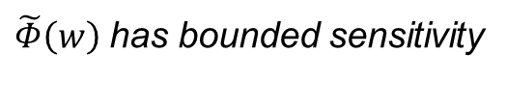



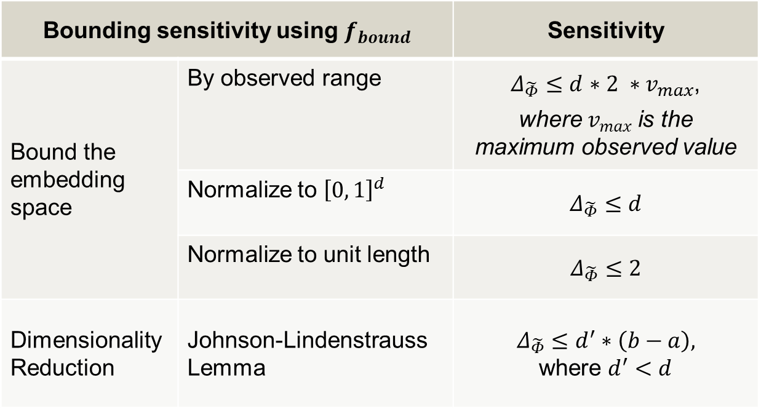
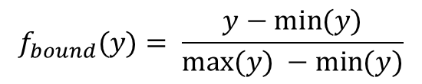
Initial Findings – Bounding Sensitivity
Concatenate $Φ$ with a function $f_{bound}$
$Φ\left(w\right)$ has unbounded sensitivity
$\tilde{Φ}\left(w\right)=f_{bound}∘Φ\left(w\right),$ s.th. $\tilde{Φ}\left(w\right)∈ {\left[a, b\right]}^{d}$
Bounding sensitivity using $f_{bound}$ |  | Sensitivity
Bound the embedding space | By observed range | $Δ_{\tilde{Φ}}≤d$ $∗2 ∗v_{max}$, where $v_{max}$ is the maximum observed value
 | Normalize to ${\left[0, 1\right]}^{d}$ | $$Δ_{\tilde{Φ}}≤d$$
 | Normalize to unit length | $$Δ_{\tilde{Φ}}≤2$$
Dimensionality Reduction | Johnson-Lindenstrauss Lemma | $$Δ_{\tilde{Φ}}≤d^{′}∗\left(b−a\right),$$ where $d^{′}<d$
$\tilde{Φ}\left(w\right)$ has bounded sensitivity
$$f_{bound}(y)= \frac{y−\min{(y)}}{\max{(y)} −\min{(y)}}$$

Slide 13
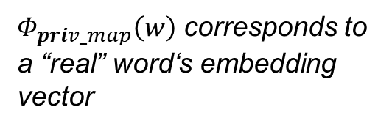

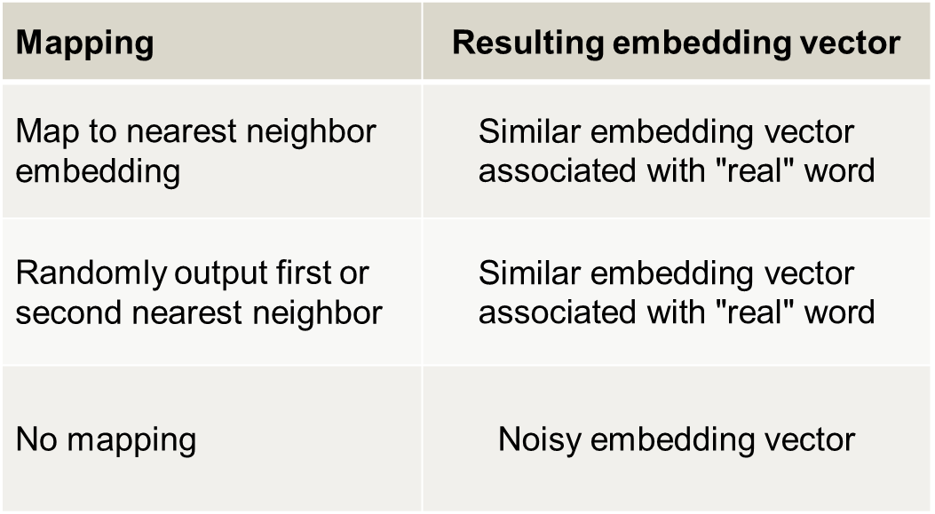
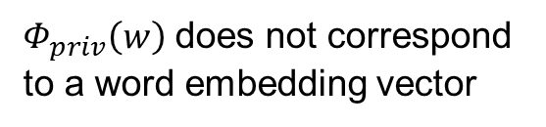
Initial Findings – Mapping to “real“ words
Concatenate $Φ_{priv}$ with a function $f_{map}$
$Φ_{priv}\left(w\right)$ does not correspond to a word embedding vector
$Φ_{priv_map}\left(w\right)=f_{map}∘Φ_{priv}\left(w\right)$, s.th.,$Φ_{priv_map}\left(w\right)∈Im(Φ$)
$Φ_{priv_map}\left(w\right)$ corresponds to a “real” word‘s embedding vector
Mapping | Resulting embedding vector
Map to nearest neighbor embedding | $$\text{S}\text{imilar} \text{embedding} \text{vector} \text{associated} \text{with} \text{"}\text{real}\text{"} \text{word}$$
Randomly output first or second nearest neighbor | $$\text{S}\text{imilar} \text{embedding} \text{vector} \text{associated} \text{with}\text{ "}\text{real}\text{"} \text{word}$$
No mapping | Noisy embedding vector

Slide 14
Outline
1. Motivation
2. Research Questions
3. Methodology
4. Initial Findings
5. Next Steps
6. Timeline

Slide 15
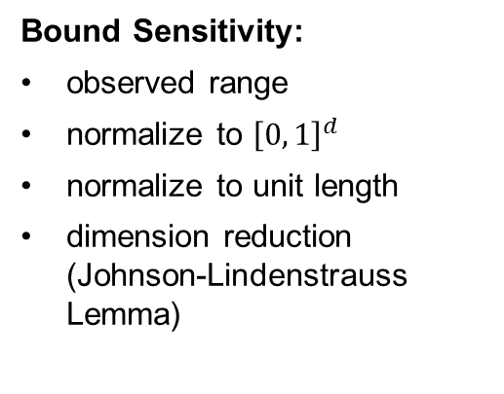
Next Steps - Experiments
Bound Sensitivity
Vector Mapping:
map to nearest neighbor embedding
randomly output first or second nearest neighbor
no vector mapping
Vector Mapping
Word Embeddings:
GloVe embeddings
FastText embeddings
Word Embeddings
DP Level*
Bound Sensitivity:
observed range
normalize to ${\left[0, 1\right]}^{d}$
normalize to unit length
dimension reduction (Johnson-Lindenstrauss Lemma)
DP Level:
Word level privacy
Document/User level privacy
Compare privatized embedding vectors

Slide 16








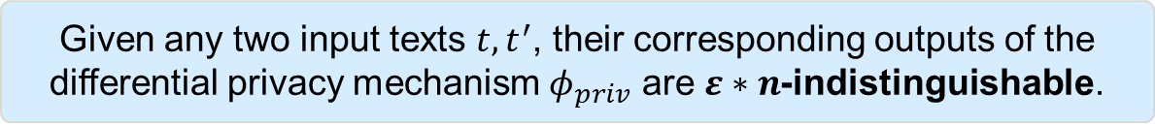


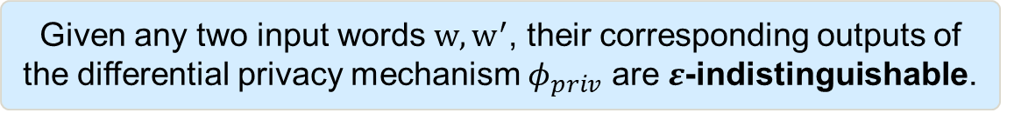
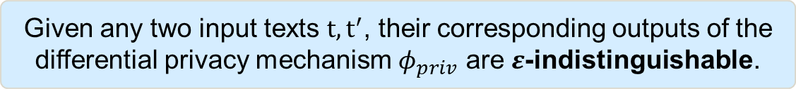
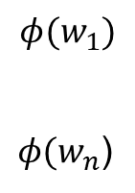
*Differential Privacy Levels – Document vs. Word Level Privacy
Document level privacy
Given any two input texts $t, t^{′}$, their corresponding outputs of the differential privacy mechanism $φ_{priv}$ are $ε$-indistinguishable.
Embedding
function $Φ$
$$w_{1}$$
$$w_{n}$$
Calibrated random noise $η$ (e.g., Laplace)
Privatized text embedding vector
Text i
….
$$η \sim Lap$$
=
$$φ({text}_{i})$$
+
$$φ_{priv}({text}_{i})$$
Word level privacy
Privatized word embedding vectors
Embedding
function $Φ$
Calibrated random noise $η$ (e.g., Laplace)
$$w_{1}$$
$$w_{n}$$
$${φ(w}_{1})$$
${φ(w}_{n}$)
+
$$η \sim Lap$$
=
$${φ_{priv}(w}_{1})$$
$${φ_{priv}(w}_{n})$$
Text i
Document level privacy
….
….
….
….
+
$$η \sim Lap$$
=
Given any two input words $w, w^{′}$, their corresponding outputs of the differential privacy mechanism $φ_{priv}$ are $ε$-indistinguishable.
Given any two input texts $t, t^{′}$, their corresponding outputs of the differential privacy mechanism $φ_{priv}$ are $ε∗n$-indistinguishable.

Slide 17
Outline
1. Motivation
2. Research Questions
3. Methodology
4. Initial Findings
5. Next Steps
6. Timeline

Slide 18

Timeline
Registration
15th Jun 2023
Kick-off Presentation
7th Aug 2023
Submission
15th Dec 2023
 | May | Jun | Jul | Aug | Sep | Oct | Nov | Dec
Literature Review
Plan Experiments
Data Preprocessing
Experiments
Evaluation of Results
Writing
Editing and Revisions

Slide 19
Alisha Riecker
alisha.riecker@tum.de

Slide 20
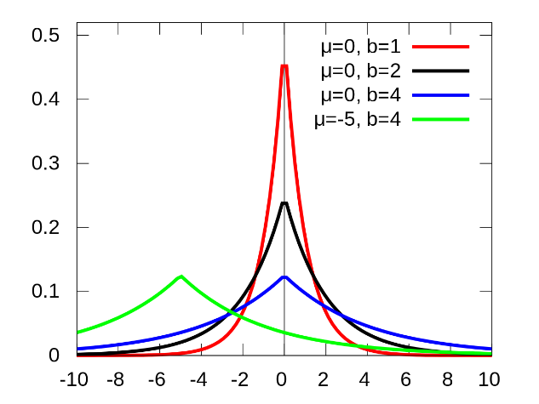
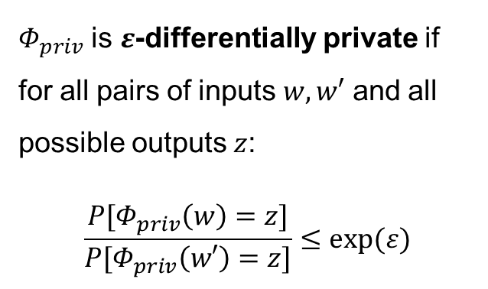
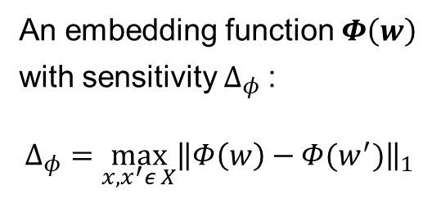
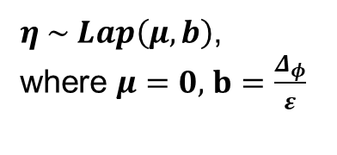
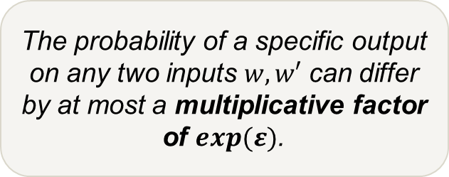
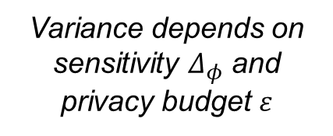
Motivation - Differential Privacy for Word Embedding Vectors
$$Φ\left(w\right)$$
(Embedding Function)
+
$$η$$
(Calibrated Random Noise)
=
$$Φ_{priv}\left(w\right)$$
(Randomized Mechanism)
Example: Laplace Mechanism
$Φ_{priv}$ is $ε$-differentially private if for all pairs of inputs $w, w′$ and all possible outputs $z$:
$$\frac{P[Φ_{priv}\left(w\right)=z]}{P[Φ_{priv}\left(w′\right)=z]}≤exp⁡(ε)$$
An embedding function $Φ\left(w\right)$
with sensitivity $Δ_{φ}$:
$$Δ_{φ}=\max_{x, x^{′}ε X}{{\left\|Φ\left(w\right)−Φ(w^{′})\right\|}_{1}}$$
$η \sim Lap\left(μ,b\right)$,
where $μ=0$, $b=\frac{Δ_{φ}}{ε}$
Sensitivity describes the maximum possible change in a function‘s output, when the input is changed.
The probability of a specific output on any two inputs $w, w′$ can differ by at most a multiplicative factor of $exp⁡(ε)$.
https://en.wikipedia.org/wiki/Laplace_distribution
Variance depends on sensitivity $Δ_{φ}$ and privacy budget $ε$
© sebis
20

Slide 21
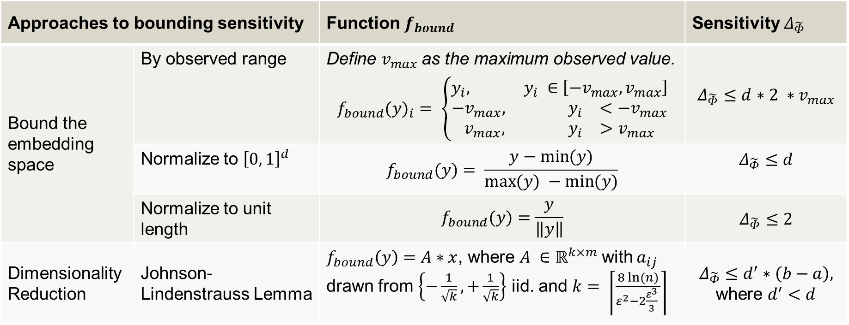


Approaches for Bounding Sensitivity
$Φ\left(w\right)$ has unbounded sensitivity
$\tilde{Φ}\left(w\right)=f_{bound}∘Φ\left(w\right),$ s.th. $\tilde{Φ}\left(w\right)∈ {\left[a, b\right]}^{d}$
Approaches to bounding sensitivity |  | Function $f_{bound}$ | Sensitivity $Δ_{\tilde{Φ}}$
Bound the embedding space | By observed range | Define $v_{max}$ as the maximum observed value. $${f_{bound}(y)}_{i}= \left\{\begin{aligned}y_{i}, y_{i} ∈\left[−v_{max},v_{max}\right] \\ −v_{max},{ y}_{i} <−v_{max} \\ v_{max}, { y}_{i}>v_{max}\end{aligned}\right.$$ | $Δ_{\tilde{Φ}}≤d$ $∗2 ∗v_{max}$
 | Normalize to ${\left[0, 1\right]}^{d}$ | $$f_{bound}(y)= \frac{y−\min{(y)}}{\max{(y)} −\min{(y)}}$$ | $$Δ_{\tilde{Φ}}≤d$$
 | Normalize to unit length | $$f_{bound}(y)=\frac{y}{\left\|y\right\|}$$ | $$Δ_{\tilde{Φ}}≤2$$
Dimensionality Reduction | Johnson-Lindenstrauss Lemma | $f_{bound}\left(y\right)=A∗x$, where $A ∈ℝ^{k×m}$ with $a_{ij}$ drawn from $\left\{−\frac{1}{\sqrt{k}}, +\frac{1}{\sqrt{k}}\right\}$ iid. and $k= \left\lceil \frac{8 ln⁡(n)}{ε^{2}−2\frac{ε^{3}}{3} }\right\rceil$ | $$Δ_{\tilde{Φ}}≤d^{′}∗\left(b−a\right),$$ where $d^{′}<d$

Slide 22
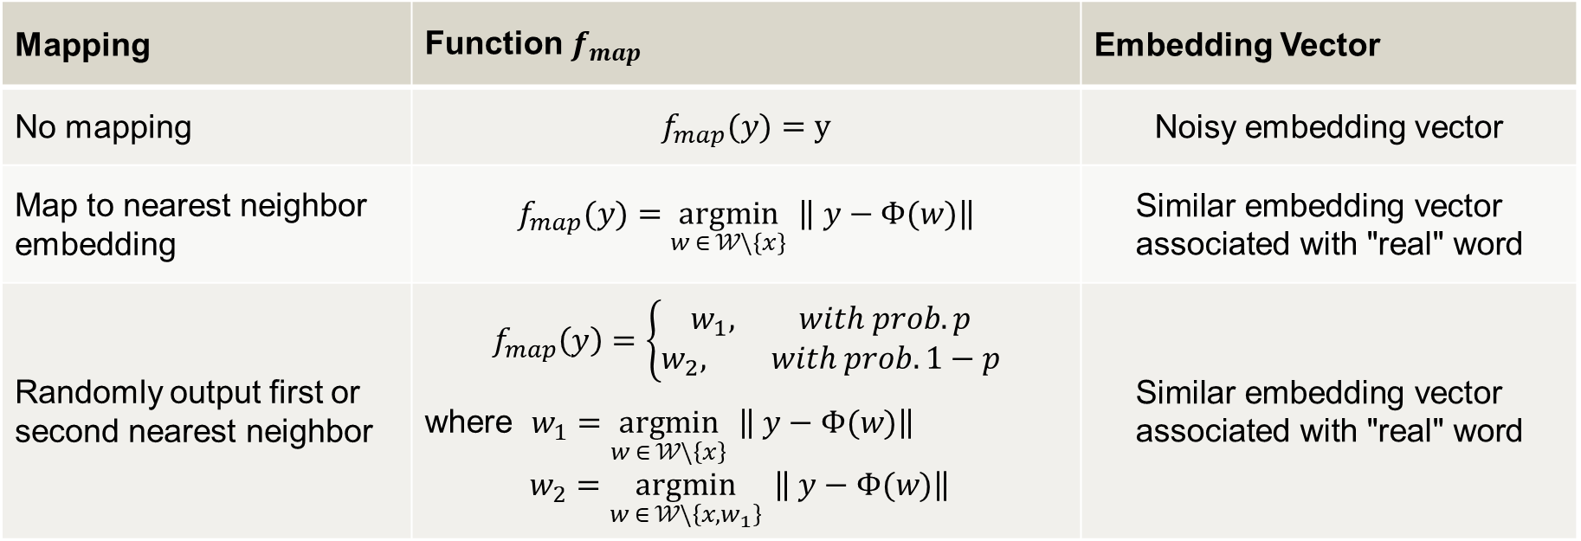
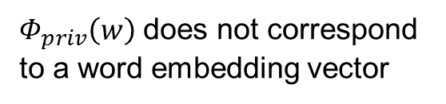
Approaches for Mapping to “real“ words
$Φ_{priv}\left(w\right)$ does not correspond to a word embedding vector
$Φ_{priv_map}\left(w\right)=f_{map}∘Φ_{priv}\left(w\right)$, s.th.,$Φ_{priv_map}\left(w\right)∈Im(Φ$)
Mapping | Function $f_{map}$ | Embedding Vector
No mapping | $$f_{map}(y)=y$$ | Noisy embedding vector
Map to nearest neighbor embedding | $$f_{map}(y)=\underset{w ∈ 𝒲\backslash \left\{x\right\}}{argmin}{ \left\| y−Φ(w)\right\|}$$ | $$\text{S}\text{imilar} \text{embedding} \text{vector} \text{associated} \text{with} \text{"}\text{real}\text{"} \text{word}$$
Randomly output first or second nearest neighbor | $$f_{map}\left(y\right)=\left\{\begin{aligned}w_{1}, with prob. p \\ w_{2}, with prob. 1−p\end{aligned}\right.$$ where $w_{1}=\underset{w ∈ 𝒲\backslash \left\{x\right\}}{argmin}{ \left\| y−Φ(w)\right\|}{ }$ $$w_{2}=\underset{w ∈ 𝒲\backslash \left\{x,w_{1}\right\}}{argmin}{ \left\| y−Φ(w)\right\|}{ }$$ | $$\text{S}\text{imilar} \text{embedding} \text{vector} \text{associated} \text{with}\text{ "}\text{real}\text{"} \text{word}$$

Slide 23
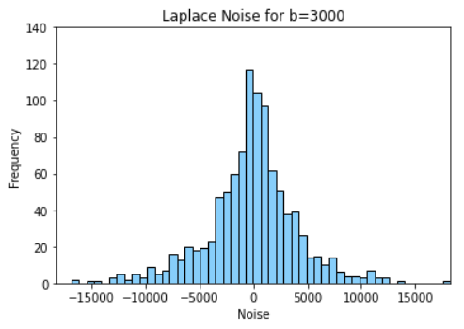
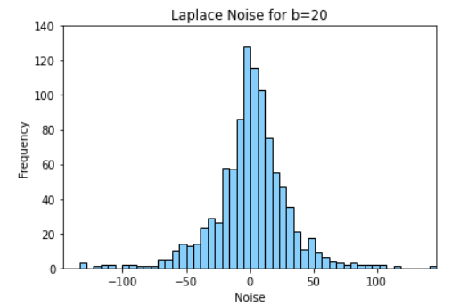
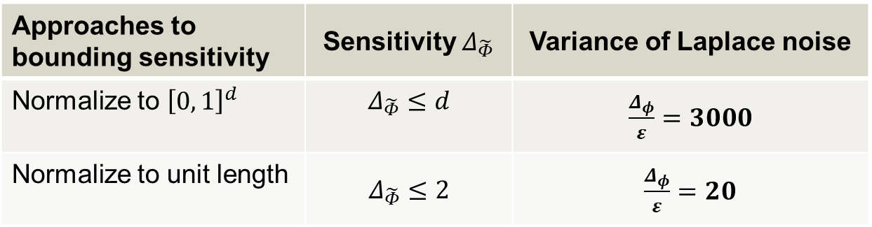



Approaches for Bounding Sensitivity
$Φ\left(w\right)$ has unbounded sensitivity
$\tilde{Φ}\left(w\right)=f_{bound}∘Φ\left(w\right),$ s.th. $\tilde{Φ}\left(w\right)∈ {\left[a, b\right]}^{d}$
Privacy budget: $ε=0.1$
Embedding function: $Φ\left(w\right): 𝒲→ℝ^{300}$
Noise: $η \sim Lap\left(μ,b\right)$, where $μ=0$, $b=\frac{Δ_{φ}}{ε}$
Approaches to bounding sensitivity | Sensitivity $Δ_{\tilde{Φ}}$ | Variance of Laplace noise
Normalize to ${\left[0, 1\right]}^{d}$ | $$Δ_{\tilde{Φ}}≤d$$ | $\frac{Δ_{φ}}{ε}=3000$
Normalize to unit length | $$Δ_{\tilde{Φ}}≤2$$ | $\frac{Δ_{φ}}{ε}=20$

Slide 24
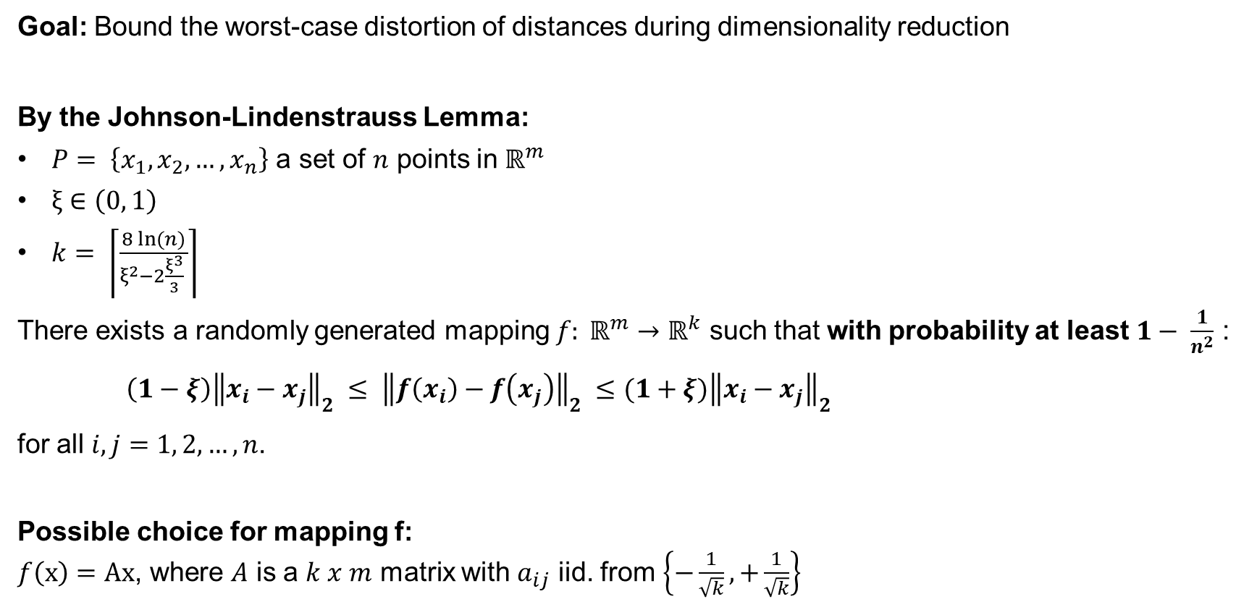
Johnson-Lindenstrauss Lemma
Goal: Bound the worst-case distortion of distances during dimensionality reduction
By the Johnson-Lindenstrauss Lemma:
$P= \left\{x_{1}, x_{2}, …, x_{n}\right\}$ a set of $n$ points in $ℝ^{m}$
$ξ∈\left(0, 1\right)$
$k= \left\lceil \frac{8 ln⁡(n)}{ξ^{2}−2\frac{ξ^{3}}{3} }\right\rceil$
There exists a randomly generated mapping $f: ℝ^{m}→ℝ^{k}$ such that with probability at least $1− \frac{1}{n^{2}}$ :
$\left(1−ξ\right){\left\|x_{i}−x_{j}\right\|}_{2} ≤ {\left\|f\left(x_{i}\right)−f\left(x_{j}\right)\right\|}_{2} ≤(1+ξ){\left\|x_{i}−x_{j}\right\|}_{2}$
for all $i,j=1, 2, …, n$.
Possible choice for mapping f:
$f\left(x\right)=Ax$, where $A$ is a $k x m$ matrix with $a_{ij}$ iid. from $\left\{−\frac{1}{\sqrt{k}}, +\frac{1}{\sqrt{k}}\right\}$

Slide 25

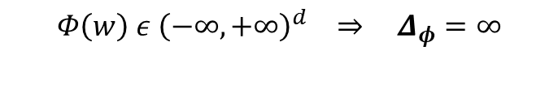
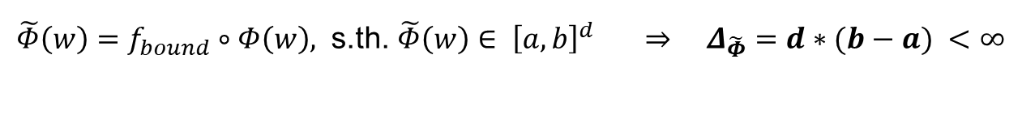
Unbounded Sensitivity
$$Φ\left(w\right)$$
(Embedding Function)
+
$$η$$
(Calibrated Random Noise)
=
$$Φ_{priv}\left(w\right)$$
(Randomized Mechanism)
Sensitivity: $Δ_{φ}=\max_{w, w^{′}ε 𝒲}\left\|Φ\left(w\right)−Φ (w^{′})\right\|$
Problem: Unbounded Sensitivity
$Φ\left(w\right) ε {\left(−∞, +∞\right)}^{d} ⇒$ $Δ_{φ}=∞$
Approach: Bound Sensitivity
$\tilde{Φ}\left(w\right)=f_{bound}∘Φ\left(w\right),$ s.th. $\tilde{Φ}\left(w\right)∈ {\left[a, b\right]}^{d}$ $⇒ Δ_{\tilde{Φ}}=d∗(b−a) <∞$
230807 | Alisha Riecker | Master Thesis Kick-off

Slide 26


$Φ_{priv}\left(w\right)$ is not a “real” word
$$Φ\left(w\right)$$
(Embedding Function)
+
$$η$$
(Calibrated Random Noise)
=
$$Φ_{priv}\left(w\right)$$
(Randomized Mechanism)
Problem: $Φ_{priv}\left(w\right)$ is not a “real” word
$Φ_{priv_map}\left(w\right)∉ Im(Φ$)
Approach: Map $Φ_{priv}\left(w\right)$ to similar embedding vectors associated with real words
$Φ_{priv_map}\left(w\right)=f_{map}∘Φ_{priv}\left(w\right)$, s.th.,$Φ_{priv_map}\left(w\right)∈Im(Φ$)
230807 | Alisha Riecker | Master Thesis Kick-off

